Slide 1
MIND BRIDGE: 1. Gleta Kijogi- Data Analyst 2. Benard Omboga- Data Analyst 3. Yvette Adhiambo- UI/UX designer 4. Jackson Mutava- UX researcher 5. Maxwel Kiambati- Project Manager 6. Nickson Safari- Product manager

Slide 2
agenda
Problem Statement
Example (User Persona)
Recommended Solution
Rationale
Employer Benefits
Next steps if funded

Slide 3
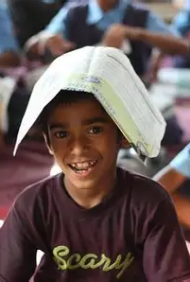
Problem statement Summary
In rural Kenyan primary schools, most children in Grades 1–6 fail to gain essential reading skills under CBC, leaving them at risk of long-term academic failure, poverty, and limited future opportunities.

Slide 4
User persona; Amina- 8yrs old
Struggles to read simple class texts.
Her teacher has 70+ students per class, making individual support impossible.
Parents cannot afford extra help.
Dreams of becoming a doctor, but without literacy, her chances are slim as she would be behind even in the next grade.

Slide 5
Data visualization
TABLE
Grade | Metric | Approximate Proficiency | Not Proficient | Source
1 | English zero readers (unable to read a word) | 23 | 77 | Tusome program impact: Grade 1 zero readers fell from 53% to 23% Reddit+5rti.org+5eRepository+5
2 | Fluent in English | 15 | 85 | Tusome: English fluency rose from 4% to 15% rti.org
3 | Reading comprehension and fluency | 22 | 78 | Study in rural Narok County: comprehension ~40 wpm iier.org.au
4 | Grade 3 level English level comprehension | 30 | 70 | National CBE report: rural public proficient peopledaily.digital
5 | No direct data available | - | - | -
6 | Grade 3 English story comprehension | 30 | 70 | FLANA results: only 30% can comprehend Grade‑3 text peopledaily.digital

Slide 6
Pie chart

Slide 7
Clustered bar chart

Slide 8
Recommended solution- mobile camp app
The mobile camp app is an offline enabled app that mimics summer camp abroad but is mostly focused on younger (grade 1-6) students. It has been thought of with 3 users in mind: the students, the teachers and the parents. For the students, it mostly serves as an interactive platform where students learn in a "fun" manner. The following were created with the students in mind: a study zone where there are interactive lessons and activities, a creativity camp aimed at nurturing a student’s talent especially in art, a progress and badges tab where the students can see their current achievements and badges. On the parents’ tab, a dashboard has been created with an overview tab where a summary of a child’s progress is given. This includes the total time they were active on the app, the lessons they’ve learnt their average score, the badges earned and their strengths. On the teachers’ segment, the total number of students he/she is teaching on the app is included as well as their average progress based on the performance of the students and the activities he/she has undertaken while on the app. A class performance chart is also provided for a simple, clear and coherent way to observe the students’ progress seamlessly.

Slide 9
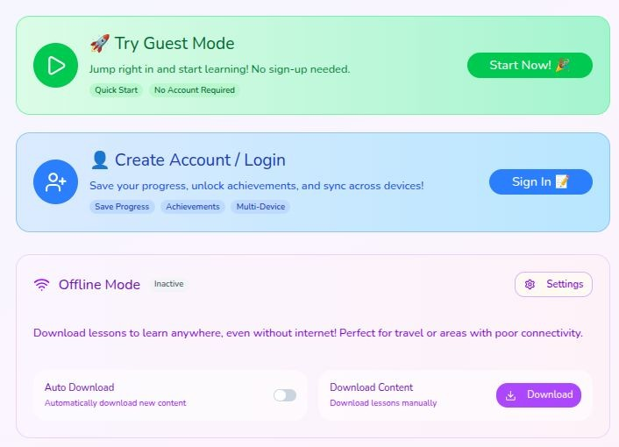
Login

Slide 10
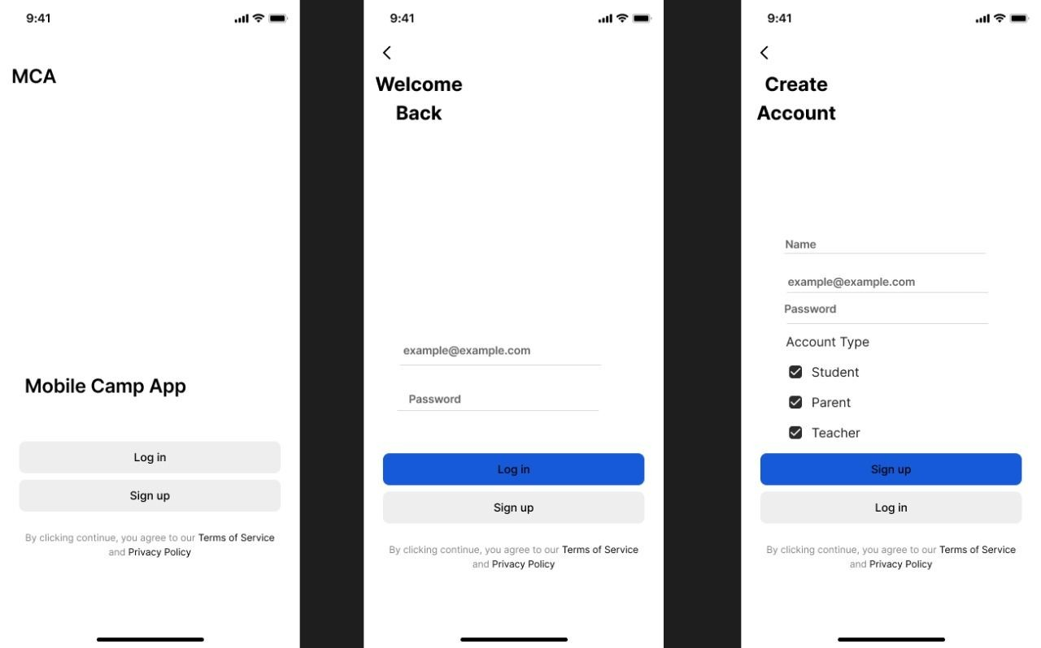

Slide 11
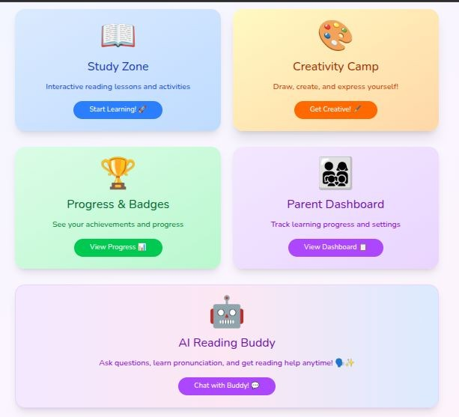
Levels & Tasks

Slide 12
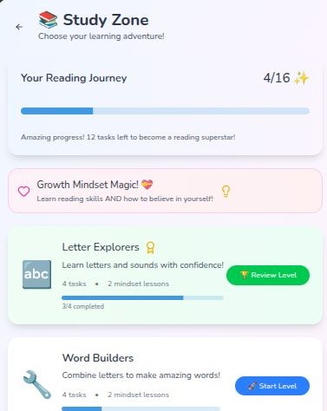
Back

Slide 14
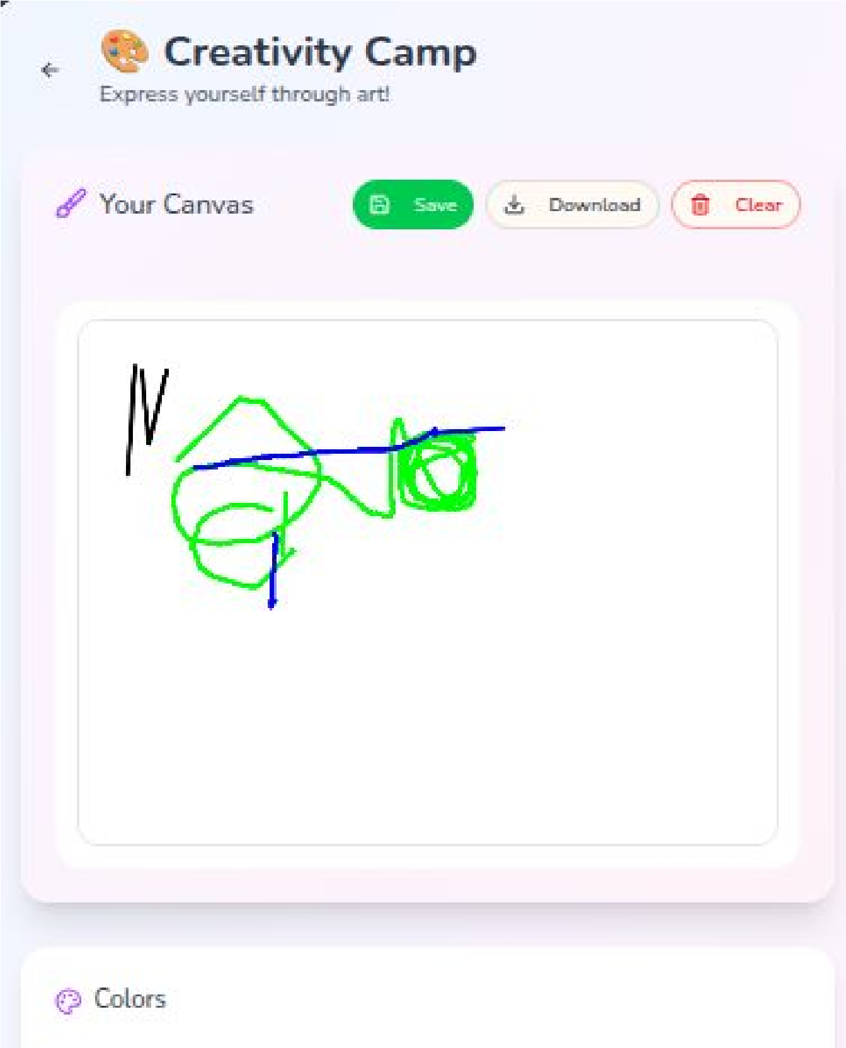
Back

Slide 15
Progress &
Badges

Slide 16
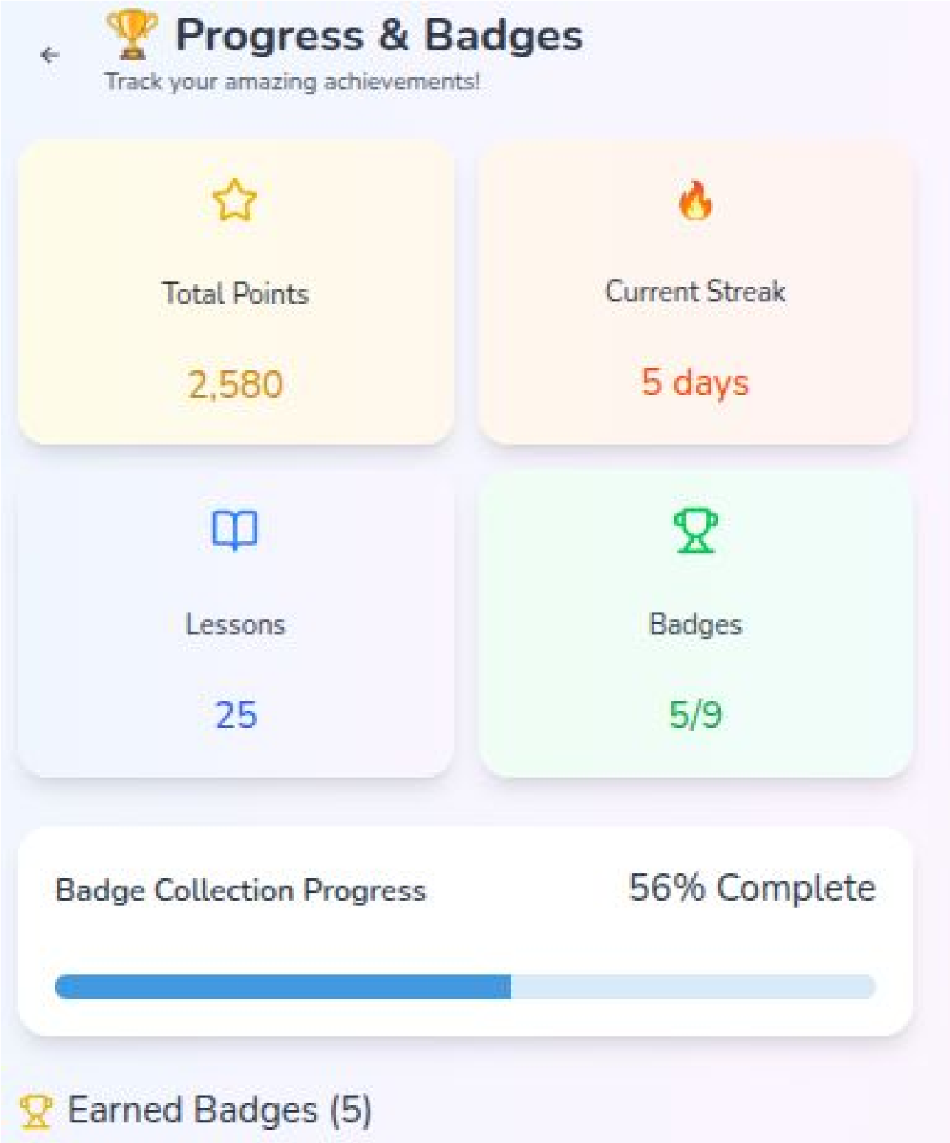

Slide 17
Dashboard

Slide 18
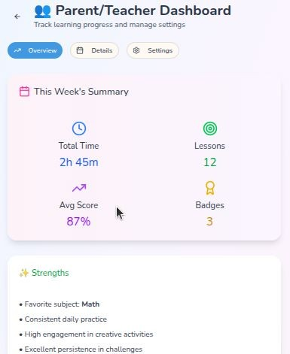
Back

Slide 19
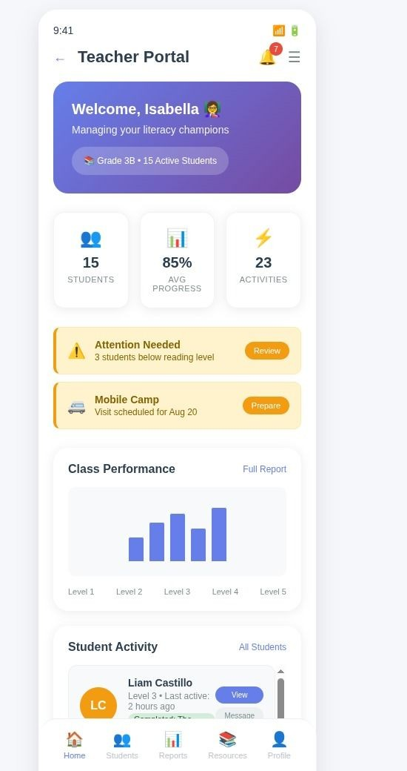
Back

Slide 20
AI Chat Bot

Slide 21
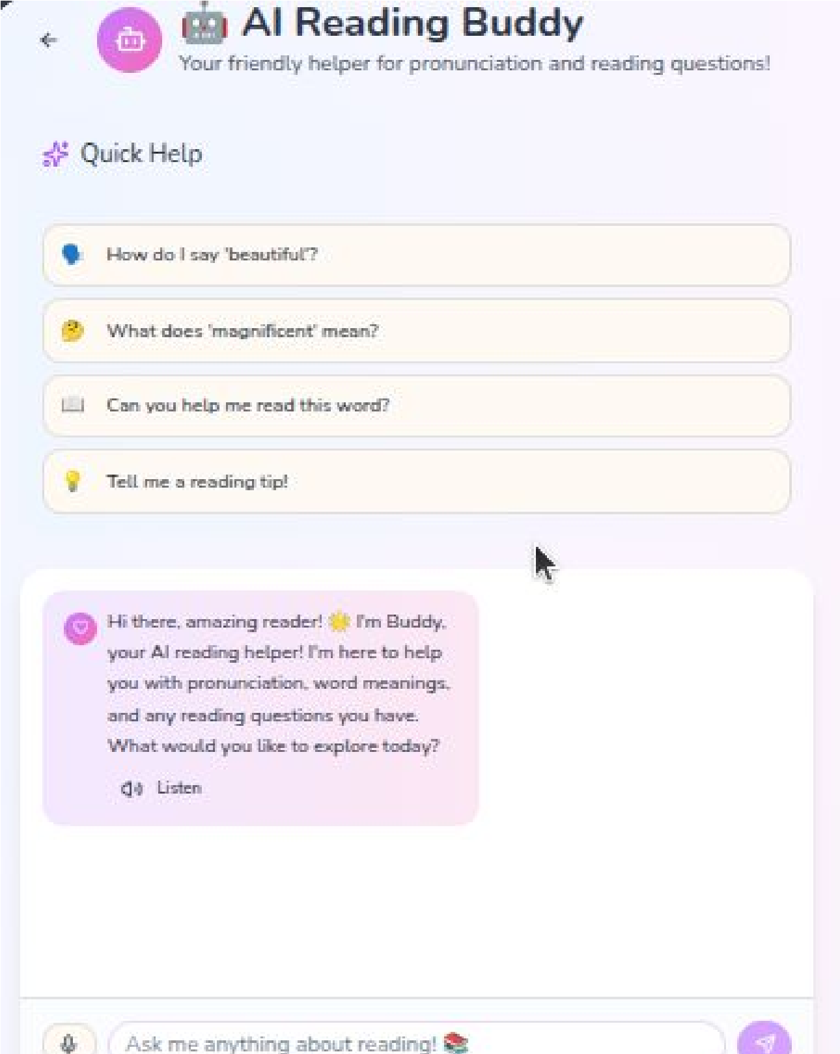
Back

Slide 22
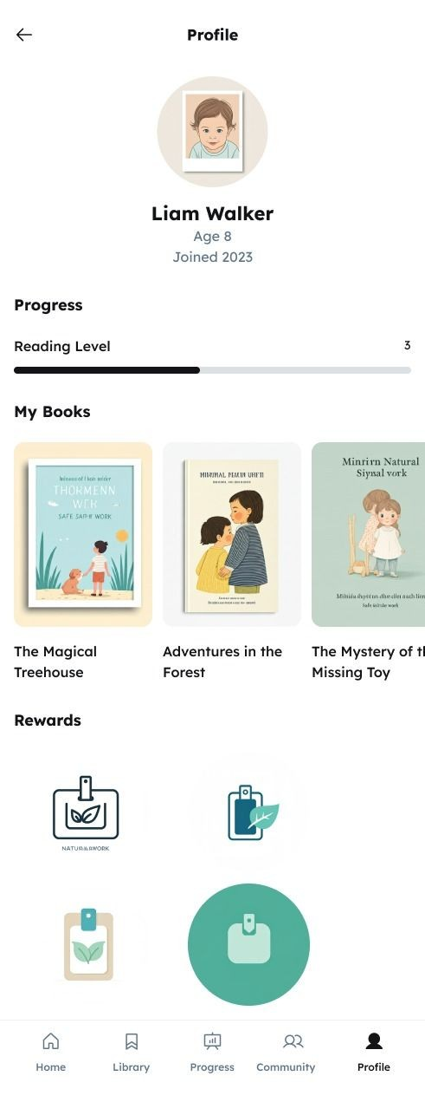
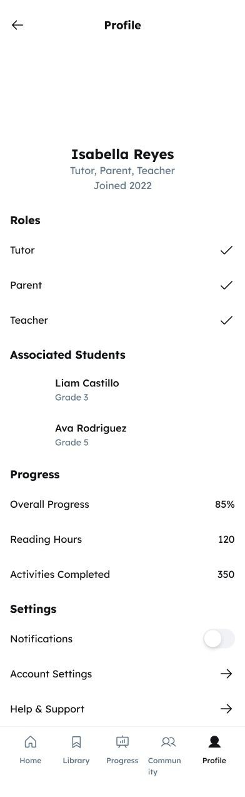

Slide 23
rationale
1. Mobile penetration in Kenya >90% → The tech infrastructure exists.
2. App-based learning = low cost, scalable, engaging.
3. Corporate Social Responsibility relevance: Education is a top priority for development partners and global impact investors.

Slide 24
NEEDS AND PAIN POINTS
USER PAINPOINTS
1. Students, a group that forms part of our users are frustrated by the fact that they are left behind during class and catching becomes really hectic making them develop a low self esteem earlier on in life.
2. Teachers, another group that forms part of our users are frustrated by the fact that a lot of pressure is put on them to ensure all the learners excel despite having inadequate learning materials and a relatively large number of students to focus on individually.
USER NEEDS
Students need an interactive system designed to help them catch up and actively learn based on the level they are at in their academic journey.
Teachers need an interactive system equipped with adequate learning materials and designed in a manner that enables them to keep track of each of the students’ progress
Parents need a system that actively includes them in their children’s learning journey.

Slide 25
CHANGES TO BE MADE BASED ON USER FEEDBACK
Add books for the learners to read to make learning more comprehensive
Add children friendly designs to the background
Add something that mimics a game for example having reading quizzes, leaderboards and badges

Slide 26
Next steps if funded
1. Minimum Viable Product development & pilot in 2–3 rural schools.
2. User testing & feedback loop with children, teachers, and parents.
3. Scale-up to more grades and communities.
4. Impact reporting to demonstrate literacy gains and Corporate Social Responsibilty Return On Investment.
5. Integration into CBC and national education ecosystem for sustainability.

Slide 27
Our why
We believe every child in Kenya deserves the chance to read, learn, and thrive. Yet, in rural and low-income communities, most children especially earlier on in their academic journey in Grades 1–6, are not acquiring essential reading skills, leaving them at risk of falling permanently behind and trapped in cycles of poverty. Owing to this, we’ve come up with a learning app idea designed to help students catch up at their own pace, support teachers with better tools, and give parents real-time visibility into their children’s progress, ensuring no child is left behind in class.

Slide 28
Thank you
Mind Bridge

